Slide 1
Movie rental data analysis
Name: Raghavendra
Batch no:DA153S15

Slide 2

Agenda
Introduction
Project Objective
Analysis
Conclusion

Slide 3
Introduction
MovieOnRent is a chain of movie rental stores in certain country. It has collection of movies in DVD and Blue Rey disc formats . Management wanted to analyze the most rented movie to stock up inventory and improve business.

Slide 4
Project Objective
To analyze successful movies belongs to which genres
To identify the most successful actors
Analyze the data of a movie rental store for further growth
To improve business.

Slide 5
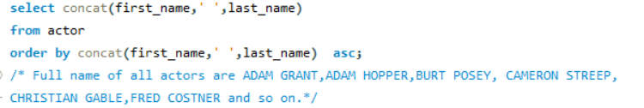
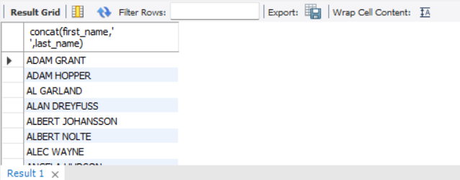
Display full names of actors available in database?
Conclusion: Full name of all actors are ADAM GRANT,ADAM HOPPER,BURT POSEY, CAMERON STREEP,CHRISTIAN GABLE,FRED COSTNER and so on.

Slide 6

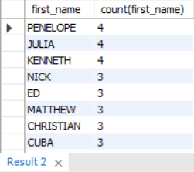
Display number of times first names appears
Conclusion: Query uses aggregate function , group by & order by clause to display number of times first name appears. some of the repeated first names are PENELOPE,JULIA,KENNETH,ED.

Slide 7
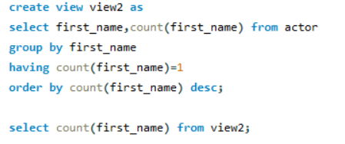


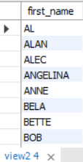
What is the Count of actors that have unique first names in database? and Display first name of these actors?
Conclusion: Count of actors having unique names are 76 .Unique first names
are AL, ALAN, ALEC,ANGELINA, ANNE, BELE AND so on.

Slide 8
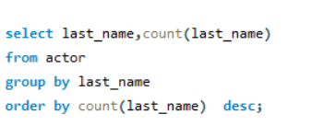
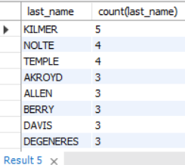
Display the number of times each Last name appears in the database
Conclusion:
Query display number of times last name appears. Kilmer appears 5 times & Nolte Appears 4 times followed by Temple and so on.

Slide 9
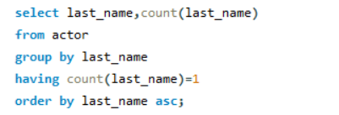
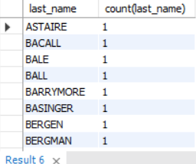
displays the Last names and number of times Last name repeated , In a descending Order of count.
Conclusion:
Query uses display Unique Last Names , Some of the unique last names are
Astaire, Bacall, Bale, Ball .

Slide 10

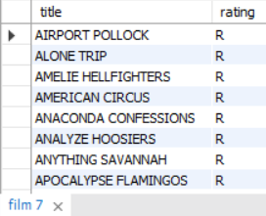
Display Movies with rating “R”
Conclusion: Query shows movies with Rating R

Slide 11

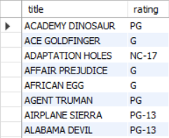
Display Movies which are not rated “R”
Conclusion: Query shows movies which are not Rating R

Slide 12

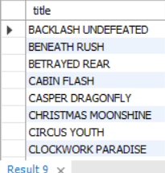
Display Movies which are suitable for audience below 13 years
Conclusion: Query shows movies suitable for children

Slide 13
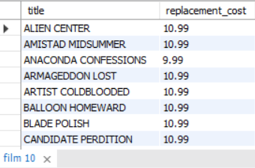
Display Movies having replacement cost up to $11
Conclusion: Query shows Movies whose replacement costs is up to $11

Slide 14
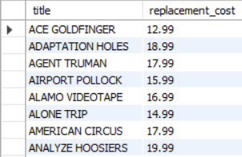
Display Movies having replacement cost between to $11 & $20
Conclusion: Query shows Movies whose replacement costs is between to $11 and $20.

Slide 15
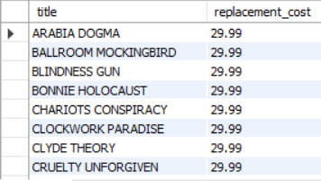
Display List of Movies in descending order of replacement cost
Conclusion:
Movies with highest replacement costs are ARABIA DOGMA,
BALLROOM MOCKINGBIRD followed by BLINDNESS GUN and so on.

Slide 16
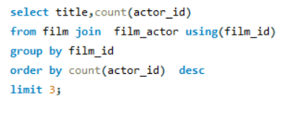

Display Top 3 movies with greatest number of actors
Conclusion: Top 3 movies with greatest number of actors are LAMBS CINCINATTI , CHITTY LOCK , BOONDOCK BALLROOM.

Slide 17
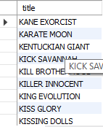
Movie title starting with K & Q
Conclusion: Query displays movie title starting with K and Q. Some of the movies are KWAI HOMEWARD , KRAMER CHOCOLATE, QUEEN LUKE,QUEST MUSSOLINI and soo on.

Slide 18
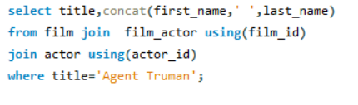
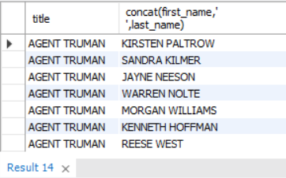
Display the Name of actors appearing in film 'Agent Truman'
Conclusion: Name of actors appearing in film 'Agent Truman' are KIRSTEN PALTROW,SANDRA KILMER,JAYNE NEESON,WARREN NOLTE,MORGAN WILLIAMS,KENNETH HOFFMAN,REESE WEST

Slide 19

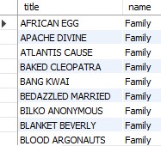
Identify movies Categorized as family films
Conclusion: Some of the family films are AFRICAN EGG,APACHE DIVINE,ATLANTIS CAUSE,BAKED CLEOPATRA,BANG KWAI,BEDAZZLED MARRIED and so on.

Slide 20

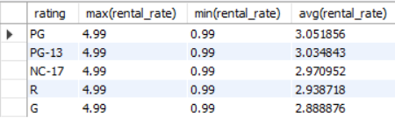
Display maximum , minimum, average rental rates of movies based on their ratings
Conclusion: Query shows Maximum , minimum , Average Rental rates of all ratings. Average rental rate of PG is more.

Slide 21
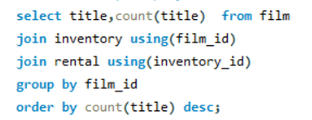
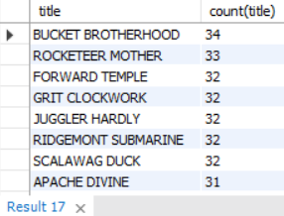
Display Movies in descending order of their rental frequencies
Conclusion: Bucket Brotherhood has more rental frequency followed by Rocketeer mother. And so on.

Slide 22
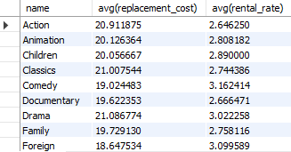
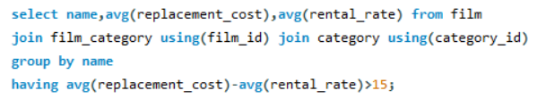
How many film Categories have average film replacement cost & average film rental rate greater than 15?
Conclusion: 16 Categories have average difference between replacement cost & rental rate greater than 15 and Categories are Travel ,Sports, Sci-Fi , New, Music , Horror ,Games, Foreign, Action & so on.

Slide 23
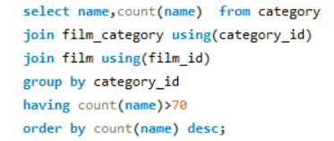

Display the Movie Categories in which the number of movies is greater than 70
Conclusion: Categories in which the number of movies is greater than 70 are Sports , Foreign & Query uses Aggregate function, group by and order by clause to display records

Slide 24
Conclusion
Movies with highest replacement costs are ARABIA DOGMA, BALLROOM MOCKINGBIRD followed by BLINDNESS GUN and so on.
Top 3 movies with greatest number of actors are LAMBS CINCINATTI , CHITTY LOCK , BOONDOCK BALLROOM
Name of actors appearing in film 'Agent Truman' are KIRSTEN PALTROW,SANDRA KILMER,JAYNE NEESON,WARREN NOLTE,MORGAN WILLIAMS,KENNETH HOFFMAN,REESE WEST
Some of the family films are AFRICAN EGG,APACHE DIVINE,ATLANTIS CAUSE,BAKED CLEOPATRA,BANG KWAI,BEDAZZLED MARRIED and so on.
Bucket Brotherhood has more rental frequency followed by Rocketeer mother. And so on.
Categories in which the number of movies is greater than 70 are Sports , Foreign.

Slide 25
THANK YOU

